Slide 1
Capstone Project
Hotel Booking analysis
Sundar K

Slide 2
Content
❑ Introduction
❑ Problem statement
Data Features
Data Summary
EDA
Result
Conclusion

Slide 3
Introduction
When we hear about hotel booking we used some application for hotel booking. The main few things I will usually consider include prices per night, distance of hotel from attractions and restaurants, availability of free breakfasts, scenery in hotel room, cleaniness of hotel room and of course, availability of free wifi. In this dataset, we ae able to know different types of bookings (i.e type of hotel, duration of stay, types of visitors, types of booking, etc).

Slide 4
Problem Statement
This data set contains booking information for a city hotel and a resort hotel, and includes information such as when the booking was made, length of stay, the number of adults, children, and/or babies, and the number of available parking spaces, among other things. All personally identifying information has been removed from the data.
Explore and analyze the data to discover important factors that govern the bookings.

Slide 5
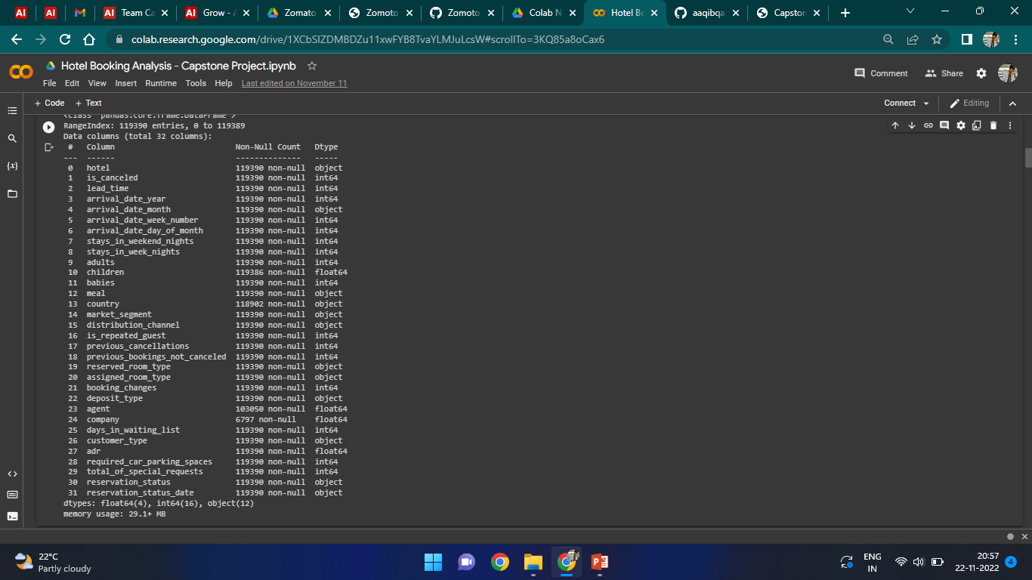
Data features

Slide 6
Data summary
hotel: The category of hotels, which are two resort hotel and city hotel. is_cancelled : The value of column show the cancellation type. If the booking was cancelled or not. Values[0,1], where 0 indicates not cancelled.
lead_time : The time between reservation and actual arrival. stayed_in_weekend_nights: The number of weekend nights stay per reservation
stayed_in_weekday_nights: The number of weekday nights stay per reservation.
meal: Meal preferences per reservation.[BB,FB,HB,SC,Undefined]

Slide 7
Country: The origin country of guest.
market_segment: This column show how reservation was made and what is the purpose of reservation. Eg, corporate means corporate trip, TA for travel agency. distribution_channel:The medium through booking was made . [Direct,Corporate,TA/TO,undefined,GDS.]
Is_repeated_guest: Shows if the guest is who has arrived earlier or not.Values[0,1]-->0 indicates no and 1 indicated yes person is repeated guest.
days_in_waiting_list: Number of days between actual booking and transact. customer_type: Type of customers( Transient, group, etc.)

Slide 8
Data Processing
We have checked for Null values
ds.isnull().sum()
Replaced with
data["children"].fillna("0",inplace=True)
data["country"].fillna("others",inplace=True)
We have checked for duplicate values
data.duplicated().value_counts()
)]
) Dropped
new_ds=data.drop_duplicates()

Slide 9
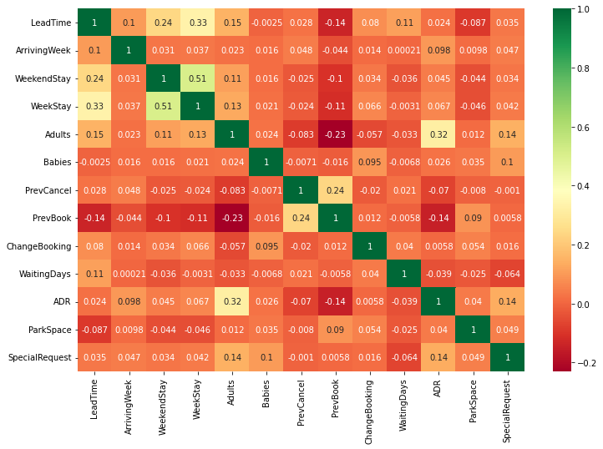
EDA

Slide 10
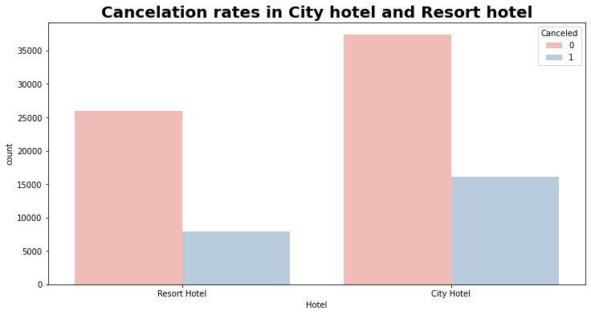

Slide 11
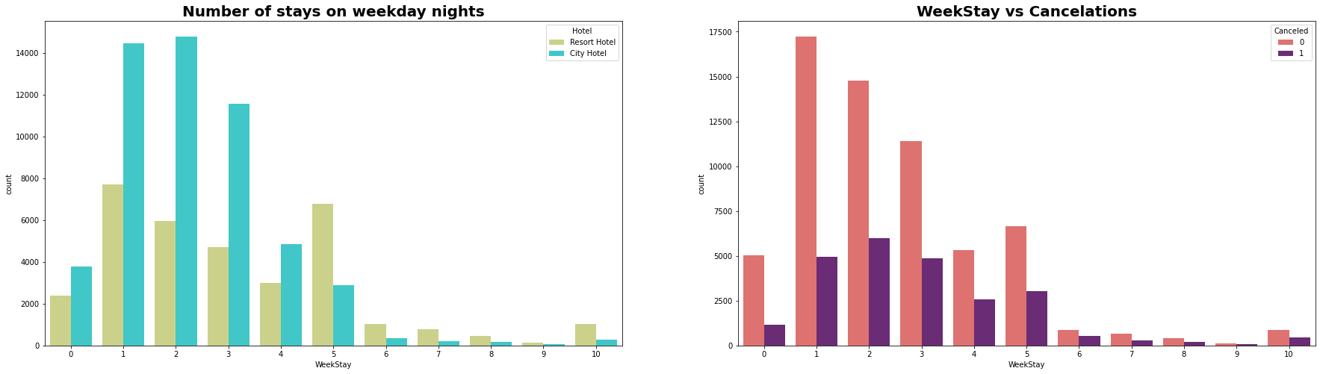

Slide 12
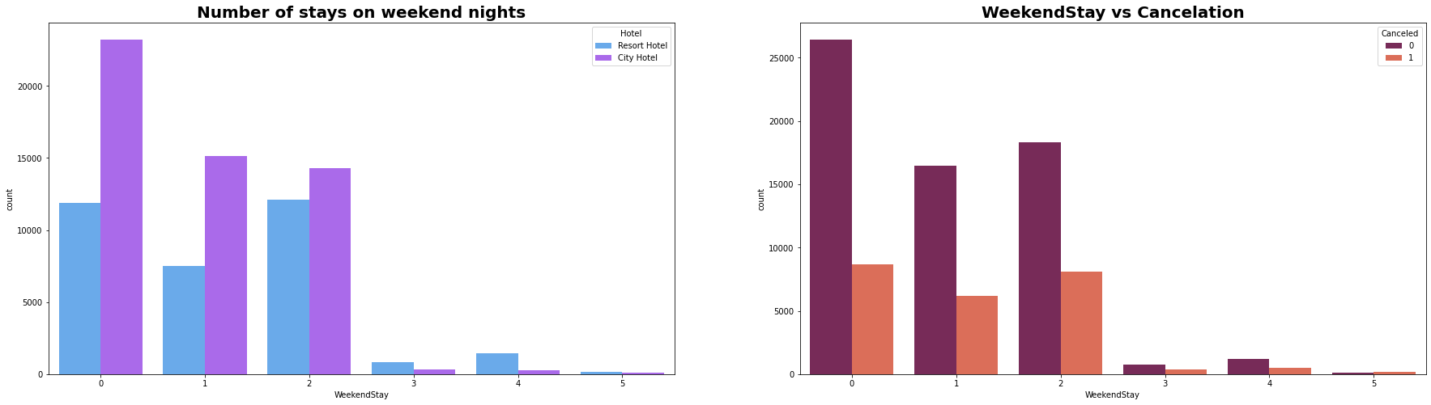

Slide 13
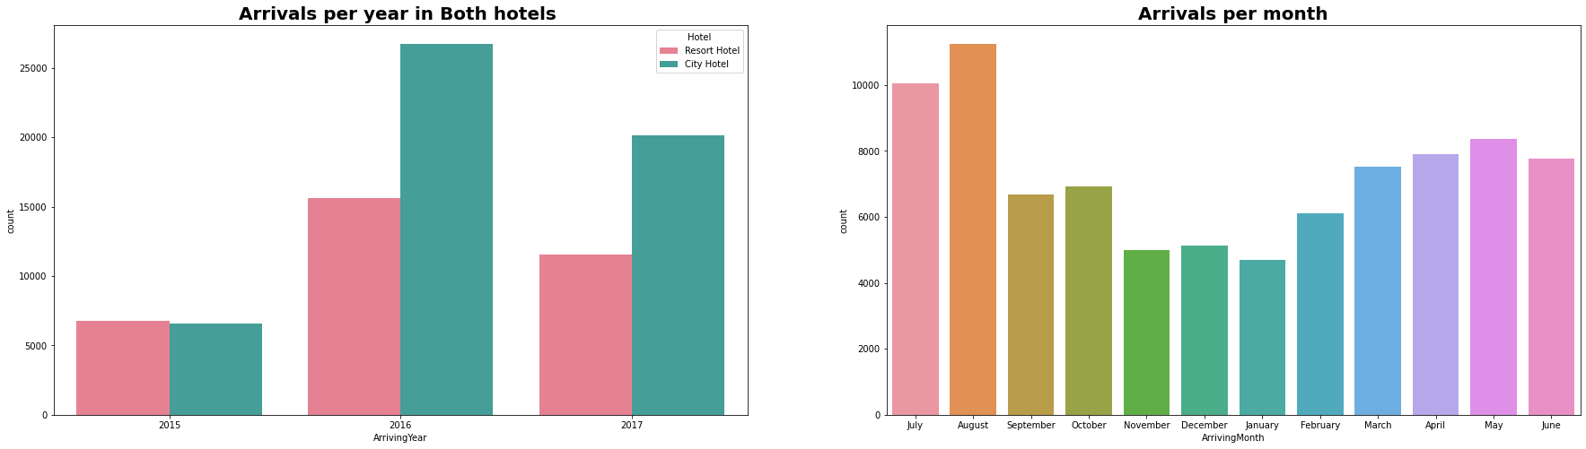

Slide 14
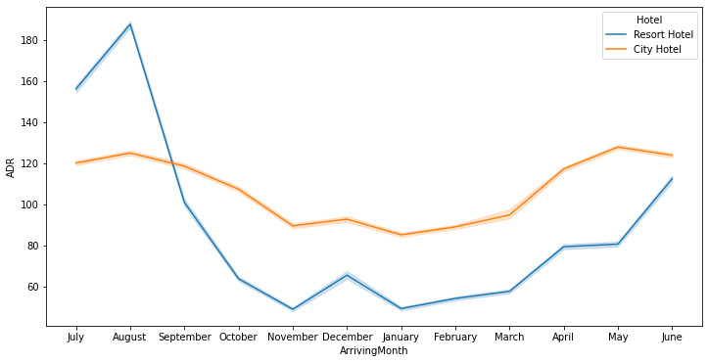
Result

Slide 15
Conclusion
Guests use different channels for making bookings out of which most preferred way is TA/TO
overall adr of City hotel is slightly higher than Resort hotel
Both hotels have significantly higher booking cancellation rates
July- August are the most busier and profitable months for both of hotels.
City Hotel is busier than Resort hotel
Couples are the most common guests for hotels

Slide 16
Thankyou

